Slide 1



ResumeKraft
Presented by-
Ritesh Kumar (21201010044)
Aman Kumar Singh (21201010007)
Mohammad Asjad Khan (21201010034)
Kunal Pandey (21201010027)
Shiv Prakash Ojha (21201010052)

Slide 2

Table of contents
01
02
03
04
05
06
Project Overview
Project Goals
Project Objectives
Requirements
Result and Findings
Methodology and Approach
09
07
08
Coding of the Project
Conclusion
Recommendations
10
Diagrams

Slide 3

01
Project Overview

Slide 4
Project Overview
ResumeKraft is an online platform designed to empower individuals in their job search.
The purpose of ResumeKraft is to provide users with a user-friendly platform for creating, editing, and downloading professional resumes.
The website will offer a range of free and customizable templates to assist users in crafting effective resumes

Slide 5
02
Project Goals

Slide 6
Project Goals
Provide User-Friendly Experience: Ensure that the platform is intuitive and easy to use for all types of users.
Offer a Variety of Templates: Provide a diverse range of high-quality, industry-specific resume templates.
Support Customization: Allow users to customize templates to meet their unique preferences and needs.
Encourage User Registration: Promote user registration to unlock additional features like saving and editing resumes.
Provide Download Options: Offer multiple download formats (PDF, Word, etc.) for user convenience.

Slide 7
03
Project Objectives

Slide 8
Project Objectives
Expand Template Library: Regularly update the template library with new and industry-specific designs.
Streamline Resume Creation Process: Implement a step-by-step wizard for users to easily input their information.
Introduce Advanced Customization Features: Allow users to customize colors, fonts, and layout of templates.
Encourage User Registration: Highlight the benefits of registration, such as saving and editing resumes.
Implement Robust Data Security Measures: Use secure encryption for user data storage.

Slide 9
04
Requirements

Slide 10
Requirements
Software Requirements:
An IDE for the development of website(VS Code)
Framework:- Django(Python)
Modules:- Reportlab
Used languages:- HTML,CSS,JS and python
Hardware Requirements:
Windows 7/8/10/11
Memory 4GB
Storage 100GB

Slide 11
05
Methodology and Approach

Slide 12
Methodology and Approach
Methodology: Agile Software Development
By combining the Agile Software Development methodology with a User-Centric Design approach, ResumeKraft can be developed iteratively, ensuring it meets user needs while maintaining flexibility to adapt to changing requirements and feedback.
Approach: User-Centric Design
Regular communication, testing, and user engagement are integral parts of this approach.

Slide 13
06
Result and Findings

Slide 14
Result and Findings
Results:
User Engagement: Measure the number of active users, registrations, and resume creations.
Template Usage: Track the popularity of different resume templates.
Download Metrics: Monitor the number and types of resume downloads.
User Registration and Login Rates: Measure the percentage of users who register and log in.
Security Audits: Conduct regular security audits to identify and address potential vulnerabilities.

Slide 15
Result and Findings
Findings:
User Preferences: Identify patterns in user preferences for template styles and features.
Impact of Updates: Evaluate the impact of any updates or new features on user engagement.
Accessibility Feedback: Collect feedback on the accessibility of the platform.
Competitive Analysis: Conduct a comparative analysis with other resume builder platforms.

Slide 16
07
Diagrams

Slide 17
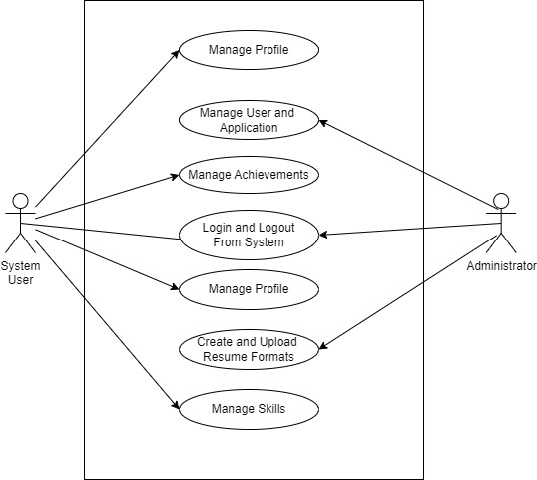
Use Case Diagram

Slide 18
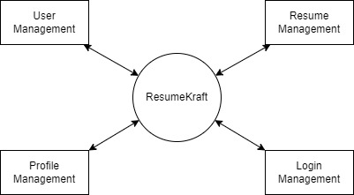
DFD 0: Context Diagram

Slide 19
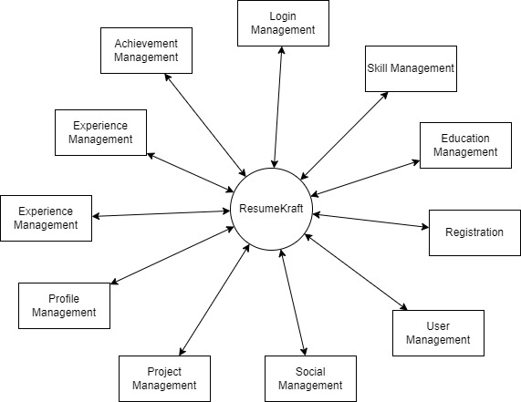
DFD 1: Process Decomposition

Slide 20
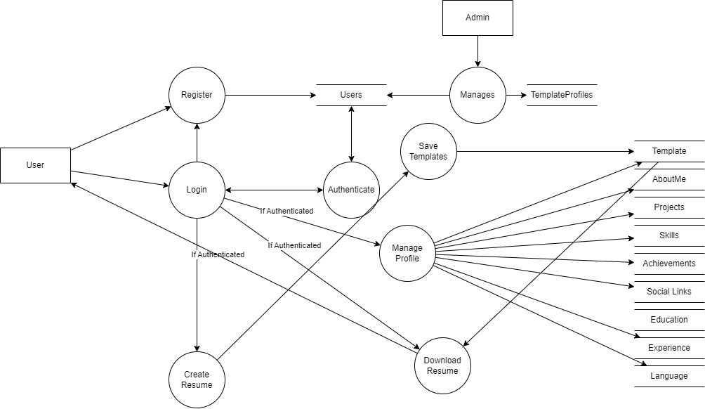
DFD 2: Deeper Dives

Slide 21
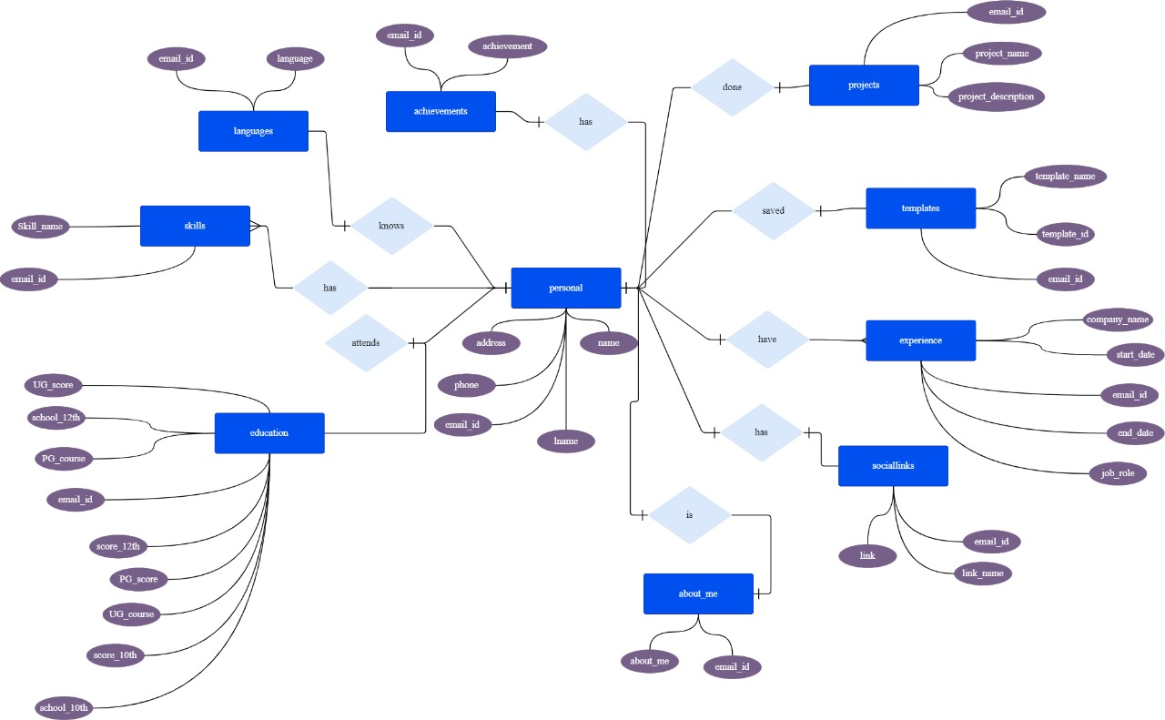
Entity-Relationship Diagrams

Slide 22
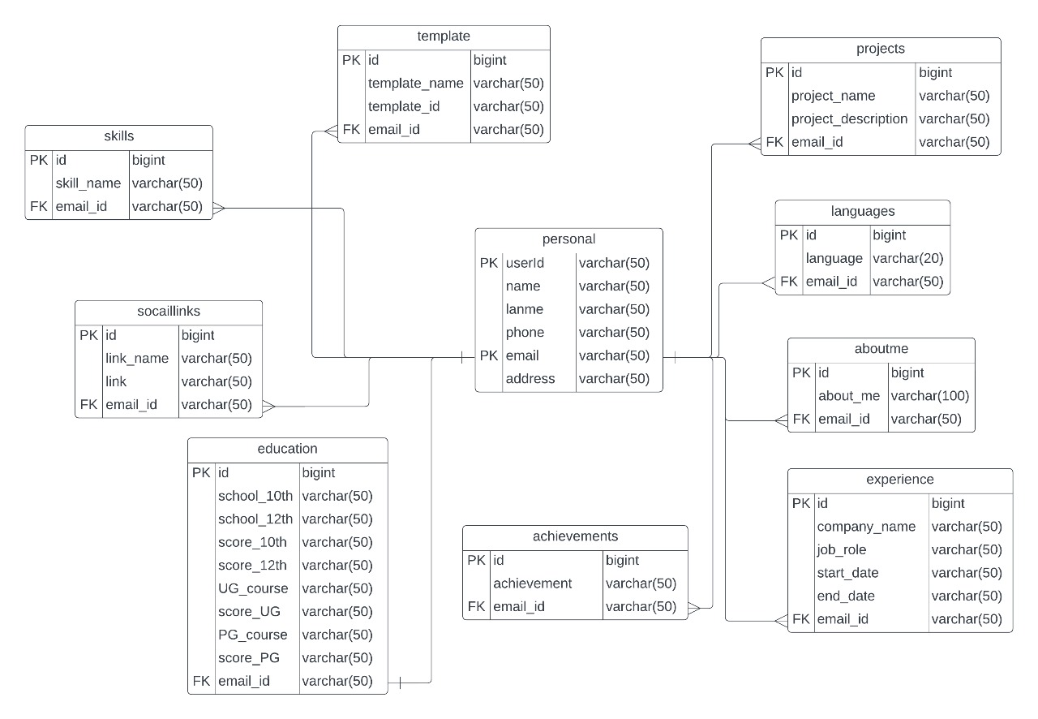
Database Diagrams

Slide 23
08
Coding of the Project

Slide 24
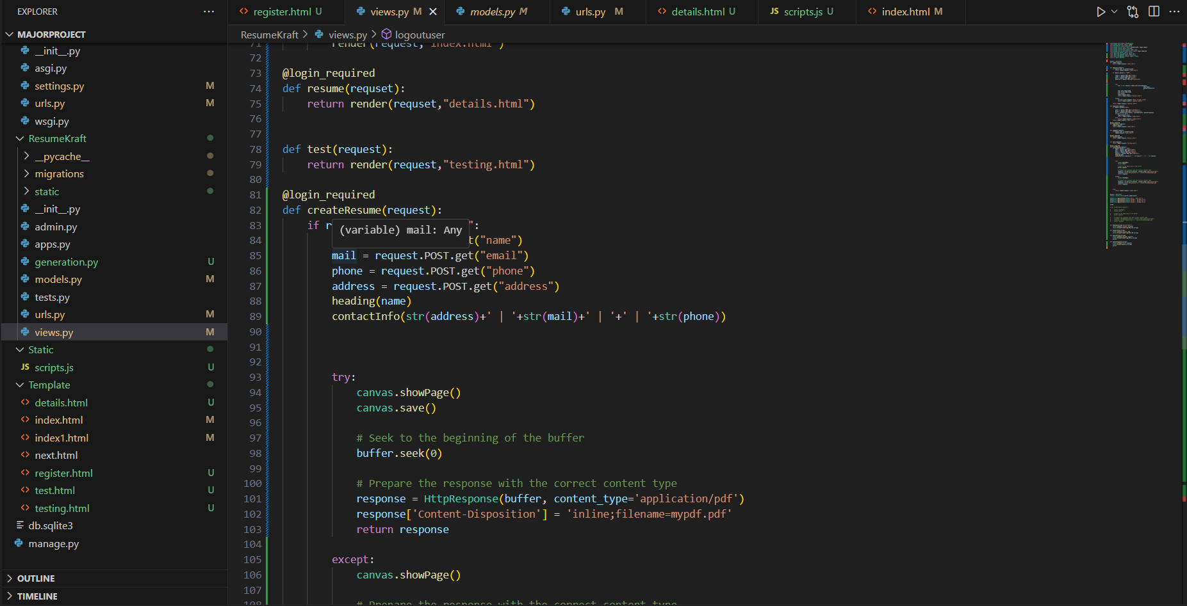
Coding of the Project

Slide 25
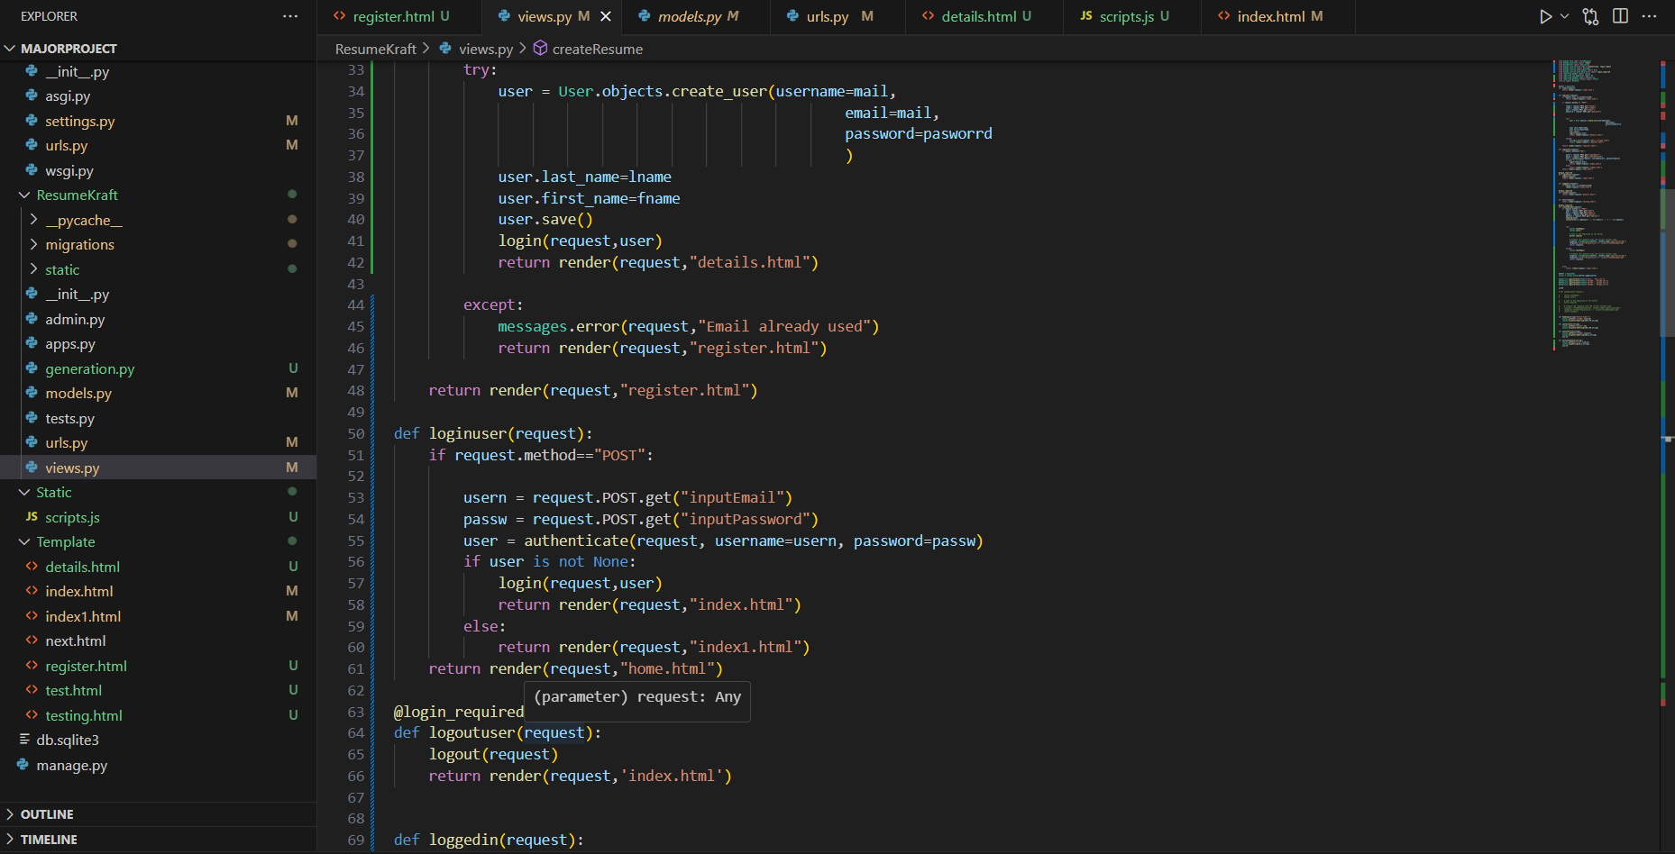
Coding of the Project

Slide 26
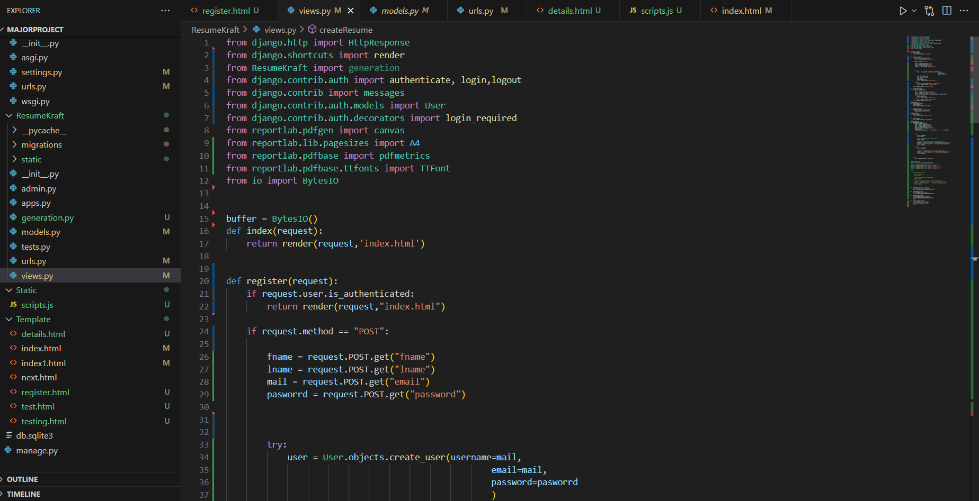
Coding of the Project

Slide 27
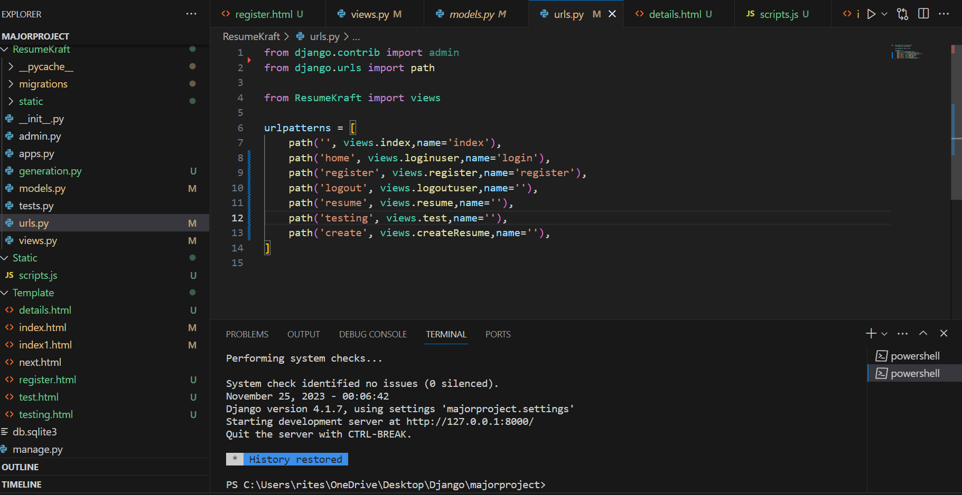
Coding of the Project

Slide 28
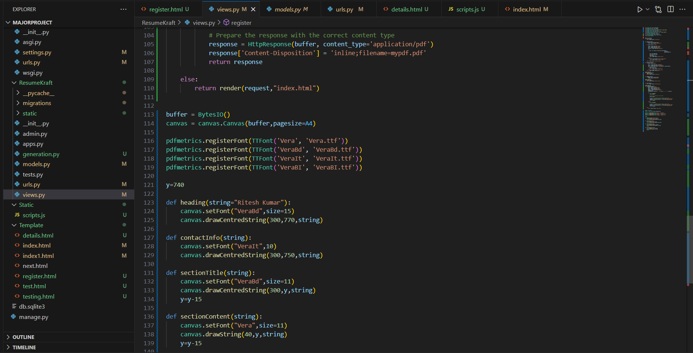
Coding of the Project

Slide 29
09
Conclusion

Slide 30
Conclusion
In conclusion, ResumeKraft stands not just as a resume builder website, but as a gateway to professional success for countless individuals.
By offering free and customizable templates, along with the convenience of user accounts for resume storage and retrieval, we aim to empower users in their career journey.
Our commitment to providing a user-friendly platform aligns with the evolving demands of the job market, ensuring that individuals can present their skills and experiences in the best light possible.

Slide 31
10
Recommendations

Slide 32
Recommendations
User Education and Onboarding: Implement an interactive onboarding process to guide users through key features.
Collaborative Editing: Introduce collaborative editing features for users working on resumes as a team and It can also allow users to personalize templates extensively as however they want.
Integration with Professional Networks: Explore integrations with professional networking platforms for easy data import.
Industry-Specific Templates: Develop industry-specific templates catering to diverse professional fields
Mobile Application Development: Consider developing a mobile application for ResumeKraft to enhance accessibility.

Slide 33
ThankYou

